Slide 1


Jayendra Harshe (Team lead)
Shubham Kapoor
Mohit Kumar
Shreya Dubey
Anirudh Bhardwaj
Krishn Kumar Ahirwar

Slide 2
Index
Abstract
Introduction
Software Requirements Specifications
Implementation
Class Diagram
Usecase Diagram
Er Diagram

Slide 3
ABSTRACT
For many years Bug Tracking mechanism is employed only in some of the large software development houses. Most of the others never bothered with bug tracking at all and instead simply relied on shared lists and email to monitor the status of defects
Bug Tracking System is a web-based application that is designed to help quality assurance and programmers keep track of reported software bugs in their work. Bugs will be assigned to a person with a bug id, flag, description, project name.
Nowadays, when project are so extensive defects or bugs have been existed as a problem in the system and they are normally inevitable in software development. A bug could be in either a program’s source code or its design.

Slide 4
Introduction
Bug Tracking System is a web-based application that is designed to help quality assurance and programmers keep track of reported software bugs in their work..
Bugs will be assigned to a person with a bug id, flag, description,
project name.
Bug can be submitted to the tester with an attachment for the bug
detailed report.
Admin can maintain user,staff, projects, bug categories, bug priorities, status of bug etc.

Slide 5
Purpose Of The Project
Bug Tracking System is to test the application for the bugs and report it to the Adminstrator.
The main intention behind the Bug Tracking System is that to track bugs and report them and resolve them.
Store the bug information with a unique id in the database and track the path.

Slide 6
Software Requirement Specification
MINIMUM HARDWARE REQUIREMENTS
Processor | I5 7th generation and above
Hard Disk | 256GB Recommended
Memory | 4GBRecommended
Display | Standard Output Display
Keyboard | Standard Qwerty Keyboard For Interface
Mouse | Standard Mouse With Two Buttons
MINIMUM SOFTWARE REQUIREMENTS
Operating System | Windows-7 and Above
User Interface | Angular
Client-side Scripting | Sprint boot
Database | Oracle
Web Server | Apache Tomcat
IDE | STS
#
5

Slide 7
Functional Requirements
MAIN MODULE
Administrator: This module has the entire access to all other modules, It can login to the app and can enter the details of staff, project, view bugs send from the customers.The admin can also also assign work to staffs, view bug case flow status details, send messages to customers using this bug tracking application.
Employee: can login to the site using username and password.
Then he/she can view the bugs assigned to them.
He can directly give solution message to customers or he/she can assign the bugs to other staffs if the bug is related to them.

Slide 8
User: he may view bug case flow details with which he/she is involved.
The customer registers in to the applications and login to the site using username and password.
Whenever a bug is raised from his software, he sends the bug details to the administrator with print screen of the bug generated.
He/she may see the bug case flow details and bug status along with remedy details at any time using the ticket number generated during new bug entry.

Slide 9
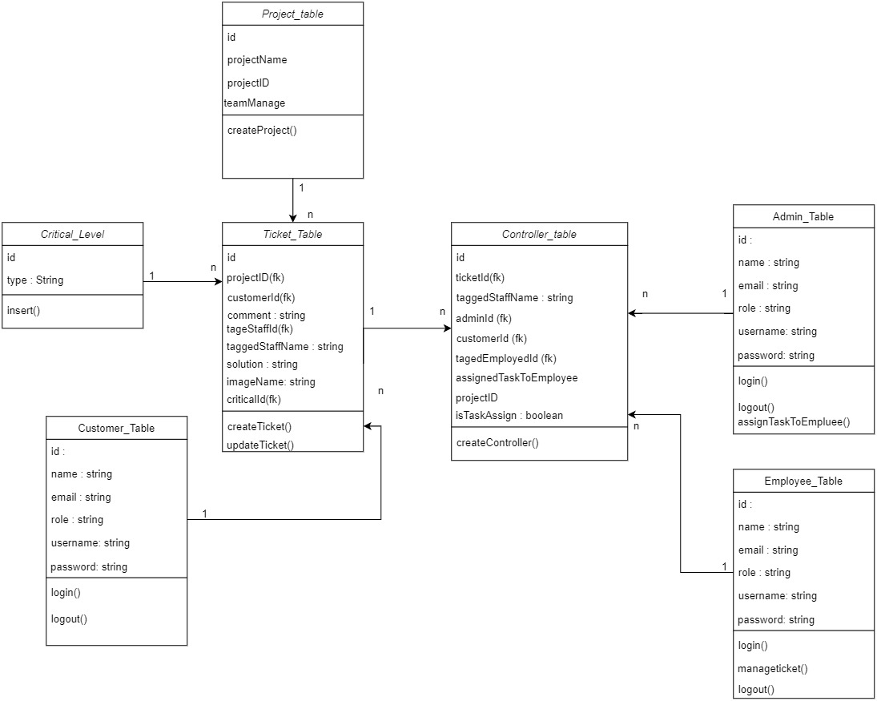
CLASS DIAGRAM
Sequence Diagram

Slide 10
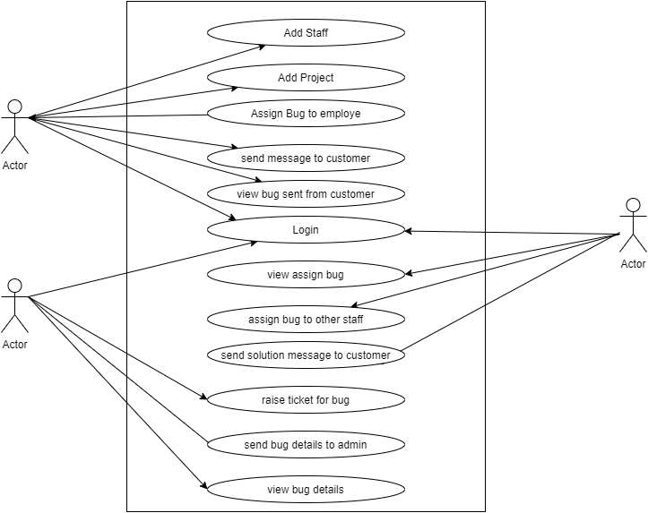
USE CASE DIAGRAM
Use case diagram

Slide 11
ER DIAGRAM
ER diagram for BTS

Slide 12



YOU
#

